Slide 1
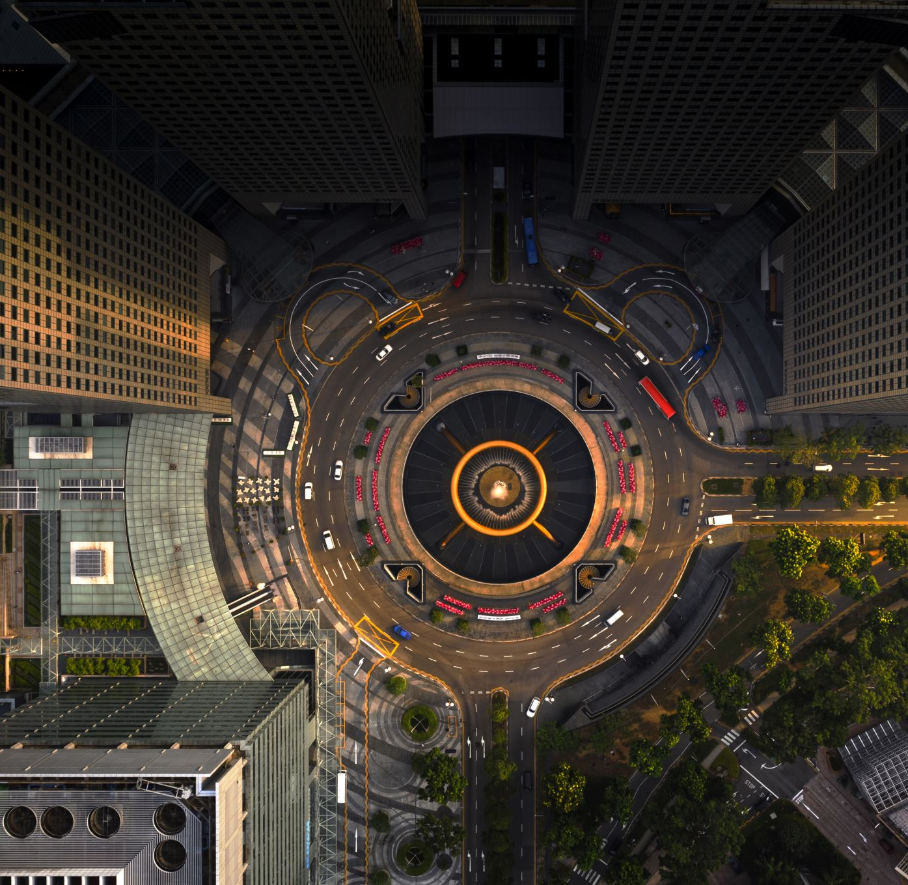
Circular Economy for Sustainability
Prasad Modak
Managing Director Environmental Management Centre Pvt Ltd
May 13, 2022
Delivered at Workshop on Youth Vision for a Circular Economy

Slide 2
Resource Security
Population expected to increase by 1.4 times in 45 years from 6.5 billion in 2005 to 9.1 billion in 2050
More than three quarters of world’s population live in countries whose national resource consumption has exceeded the nation’s resource availability
The issue is not just consumption of resources but the degradation of resources due to poor management of residues
To compound we now have a looming threat of climate change leading to shifts and uncertainty
The Global Resource Security is therefore at a risk than never before
Data sourced from WRI, Earthtrends

Slide 3
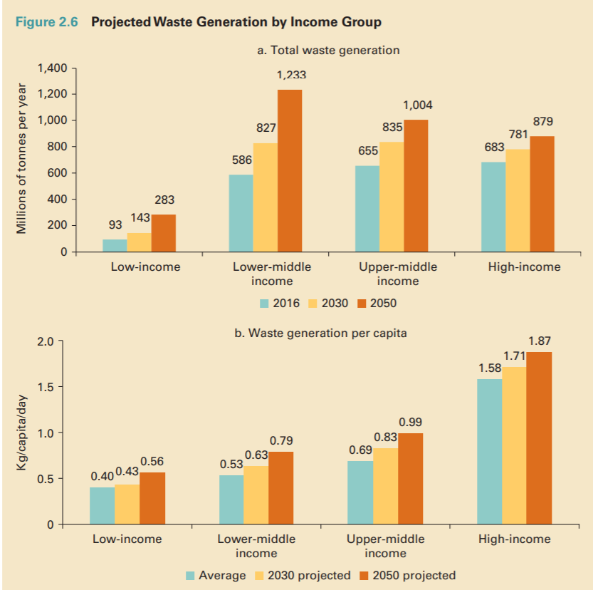
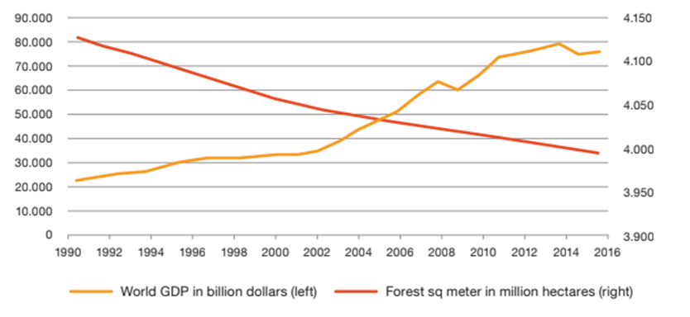
Economic growth, resource depletion and degradation
Need to decouple Economic growth from resource depletion and environmental degradation
Waste generation per capita
GDP Vs Forest Degradation
Source: World Bank
Source: The World Bank Food and Agriculture organization

Slide 4
The Evolution of Circular Economy
Germany/EU
Circular
Economy
Resource Efficiency
Secondary
Material Recycling
Korea
APO
Green
Growth
Blue
Economy
Green
Productivity
RECP
Reduce
Reuse
Recycle
Sound
Material
Society
UNIDO/UNEP
WBCSD
Cleaner
Production
Japan
Green
Economy
ISO 14001 EMS
Eco-
Efficiency
Life cycle thinking
UNEP/UNIDO
Eco-design
Pollution
Prevention
Cradle to Cradle
Waste
Minimization
Factor 10
© Dr. Prasad Modak
USEPA
1970
1980
1990
2000
2010

Slide 5


The Transition
or Transformation?
Linear Economy
Circular Economy
Collaborative Consumption
Resources
Dematerialization
Use of Local and
Renewable sources
Production
Throw away society!!!!
Responsibile society!!!!
Extending life of products
Consumption
Recovery of resources
Increase virtualization
Waste
Inclusive Growth

Slide 6
Understanding Circular Economy
… is a regenerative economic system which focuses on transitioning from ‘take-make-dispose’ models to ‘take-make-use-regenerate’ resource models.
… it aims to redesign the production and consumption systems.
… it is a new model for sustainable development and green economies.

Slide 7
Defining Circular Economy
Definition by EU - In a circular economy, the value of products and materials is maintained for as long as possible. Waste and resource use are minimised, and when a product reaches the end of its life, it is used again to create further value. This can bring major economic benefits, contributing to innovation, growth, and job creation.
Definition by Ellen MacArthur - A circular economy is based on the principles of designing out waste and pollution, keeping products and materials in use, and regenerating natural systems.
Definition as per Circular Economy Law in China - The Circular Economy herein is the general term for the activities of decrement, recycling and resource recovery in production, circulation, and consumption.
Decrement herein means the reduction of the resource consumption and waste generation in production, circulation, and consumption.
Recycling herein means the direct use of wastes as products, or the use of wastes as products after the repair, renovation or reproduction of them, or the use of wastes, wholly or partly, as parts of other products.
Resource recovery herein means the direct use of wastes as raw material, or waste regeneration.
Notes:
There are more than a hundred definitions of the term circular economy . Most of the definitions emphasize reduce, reuse, and recycle activities, and often do not highlight that circular economy requires a systemic shift in the economy and behavioral change.
The definition by China is more operational while the European Union (EU) definition emphasizes how life cycle thinking spells out the outcomes or benefits. Decoupling is not explicitly stated.

Slide 8
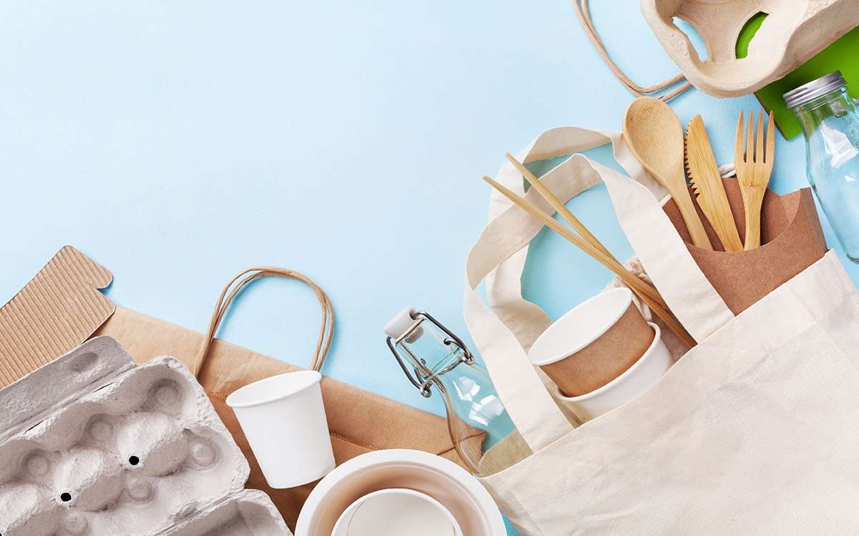
The key principles of a circular economy are to reduce consumption of natural resources, and reuse materials before recycling them
At present, only 12% of secondary materials and resources in the EU are returned to the economy after use
Less than 1% of clothing material is recycled to make new clothing.
55% of plastic waste is discarded rather than recycled.

Slide 9
Circularity– 3R Plus 3Rs (and more..)
© Dr. Prasad Modak

Slide 10
CE’s Distinguishing Feature
The Outer and Inner Circles
Recycle, Recover, Remanufacture
The "outer circle" –creates a closed loop of materials. More for big businesses
The inner circle is people centric, it is for citizens, small companies and community initiatives to reinvent.
However, the Bulls Eye is the first priority
Avoid, Reduce, Redesign
Repair, Refurbish, Reuse

Slide 11

Four Circles of Circular Economy
Transformative with innovation
Cutting down consumption of virgin resources
Re-Design, Rethink
Refuse , Reduce, Reuse
Recycling at Project Level
Circular Economy
Adding value with tech/ creating green jobs
Extending product life
Return , Recycle, Recover, Remanufacture
Repair, Refurbish, Renovate

Slide 12
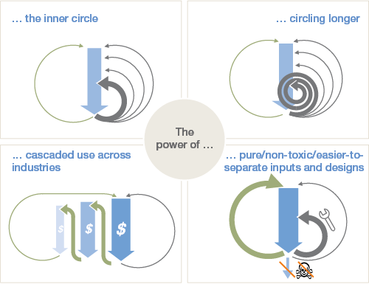
Circular Economy
A Principle based Material Management?
Inner Circle – Minimising comparative materials use, through re-use. The tighter the circle, the less it has to be changed to be returned to use (with higher savings)
Circling Longer – Maximising the number of consecutive cycles of reuse, to avoid production of a new component
Cascading– Diversified re-use across the value chain, substituting previously used virgin materials with existing materials (including symbiosis
Pure inputs – Avoidance of contaminated materials to increase collection and re-use efficiency whilst maintaining quality
Source: Ellen Macarthur Foundation

Slide 13
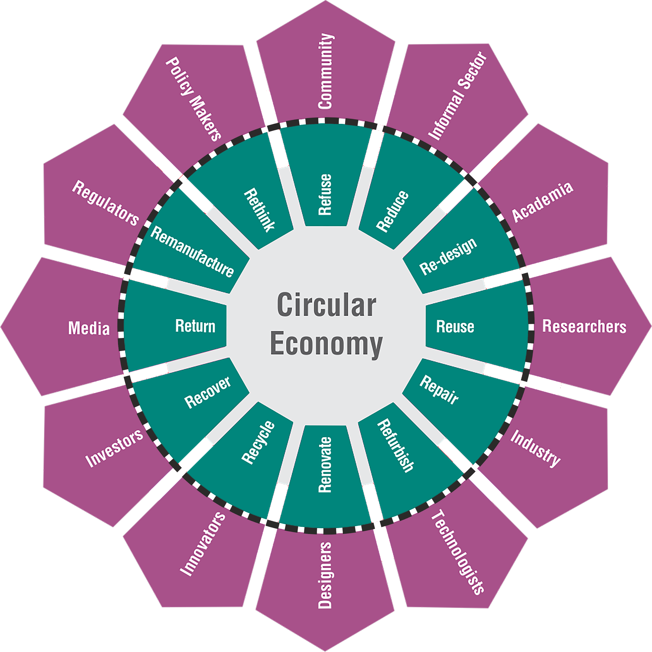
The 12Rs
© Dr. Prasad Modak

Slide 14
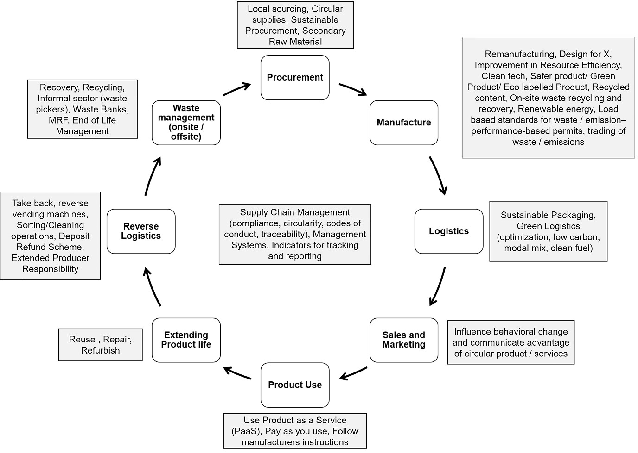
Circular strategies across life cycle (12Rs)
All stages of life cycle e.g. sourcing of materials, design, production, distribution, consumption, and waste management need to be addressed for a balanced governance.
Involving communities and bringing in a behaviour change is extremely critical.
Notes:
life cycle thinking plays a very important role to close the technical and biological flows. Experience has shown that one of the critical pillars is stakeholder consultation and involvement. All stages of life cycle e.g. sourcing of materials, design, production, distribution, consumption, and waste management need to be addressed for a balanced governance. Involving communities and bringing in a behavior change is extremely critical. Figure 11‑2 presents strategies that can be considered for transitioning to circular economy at various stages of the life cycle. Many of these strategies with examples have already been discussed in earlier chapters.

Slide 15

Sustainable Procurement is an important driver to circular economy “upstream”. It links production with consumption

Slide 16
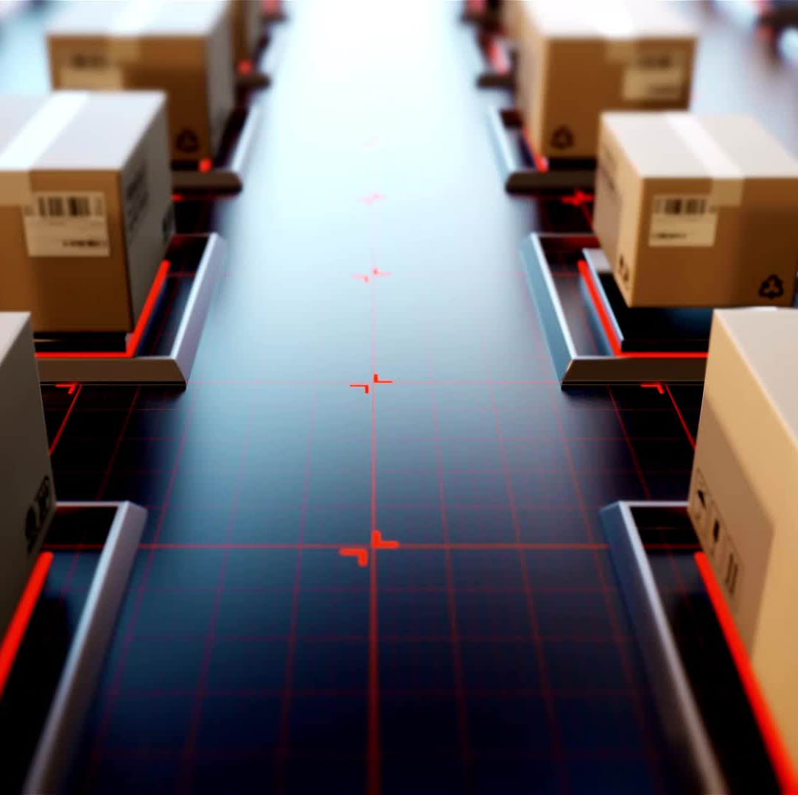
Extended Producer Responsibility : The SHIFT and PUSH in India : “From Downstream to Upstream”
Can be a game changer
Complex when material flows are through informal sector
Capturing Data and Tracking can be challenging
Social perspectives or inclusive approach need to be brought in
Need for an overarching EPR framework
How can be leverage EPR and CSR – together?

Slide 17
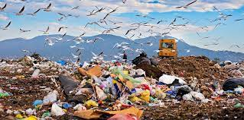
Can we see a city with no landfill?
Sending materials to landfills should be the last resort

Slide 18
Is there a “Socially optimal recycling rate?” Evidence from Japan
Kinnaman and colleagues evaluated in 2014 the cost of recycling each material and the energy and emissions involved in recycling. Benefits were also assessed including simply feeling good about or doing something for environment.
He and his colleagues come to a controversial conclusion that an optimal recycling rate in most countries would probably be around 10 percent of the used goods.
To get the most benefit with the least cost, Kinnaman argued that we should be recycling more of some goods and less — or even none — of others. The composition of 10% should contain primarily aluminum, other metals and some forms of paper, notably cardboard and other source[s] of fiber.

Slide 19
Kinnaman’s 10% conclusion
Although several disagreed with Kinnaman’s 10% conclusion, his point that we need to be selective about what we recycle —resonated well with environmentalists and waste management experts alike.
Kinnaman was asking two basic questions about recycling:
Is it good for the environment?
And does it make economic sense?
But you may ask – isn’t recycling a moral responsibility?
Or aren’t these computations reflect our short-term thinking and not about the sustainability.
Here mere economic approach may fail

Slide 20
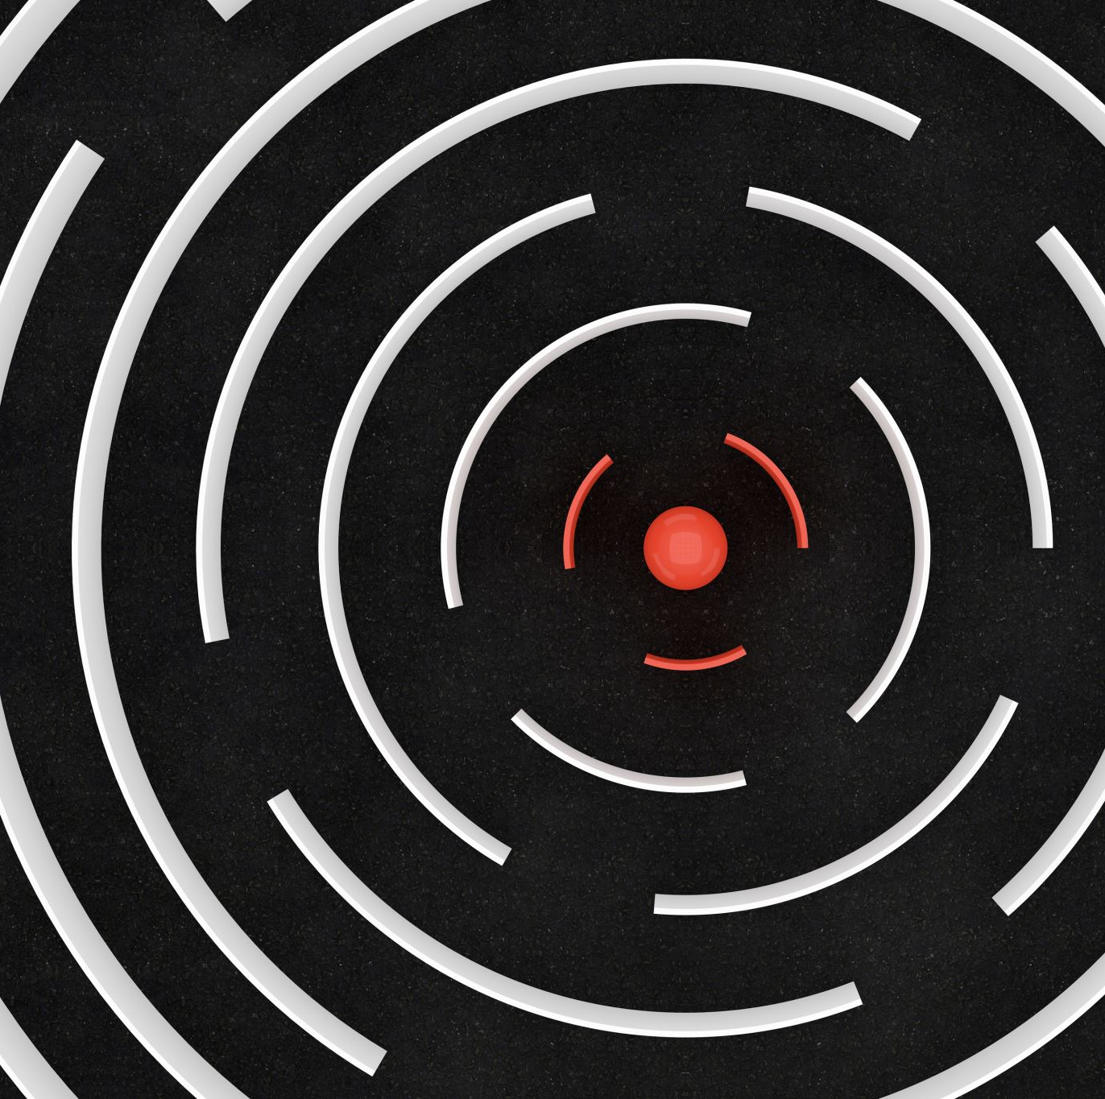
Circularity and Carbon Neutrality
Decarbonization strategies – when address Scope 3 emissions, there will be economy wide impacts.
A transformation
BRSR over supply chains focusing on GHG emissions
Expanding Envelopes
Circular Procurement
Circular Supply Chains

Slide 21
Bioeconomy
India registered a sustained growth in bioeconomy from USD 44 billion in 2019 to 80.1 billion in 2021. India has now set a target of USD 300 billion in bioeconomy by 2030. Bioeconomy is the production, utilization, and conservation of biological resources, including related knowledge, science, technology, and innovation, to provide information, products, processes, and services across all economic sectors.
The European Commission defines the bioeconomy as "the production of renewable biological resources and the conversion of these resources and waste streams into value added products, such as food, feed, bio-based products and bioenergy. Its sectors and industries have strong innovation potential due to their use of a wide range of sciences, enabling and industrial technologies, along with local and tacit knowledge." Source: "Innovating for Sustainable Growth - A Bioeconomy for Europe" (2012)

Slide 22
The concept of bioeconomy goes far beyond the (“brown”?) circular economy
The circular economy strengthens the eco-efficiency of processes and the use of recycled carbon to reduce the use of additional fossil carbon.
The bioeconomy substitutes fossil carbon by bio-based carbon from biomass from agriculture, forestry and marine environments. These are different but complementary approaches.
Bioeconomy includes a lot more aspects than circular economy such as new building blocks, new processing routes, new functionalities and properties of products.
https://www.brain-biotech.com/blickwinkel/circular/the-bioeconomy-is-much-more-than-a-circular-economy/#:~:text=The%20circular%20economy%20strengthens%20the,are%20different%20but%20complementary%20approaches.

Slide 23
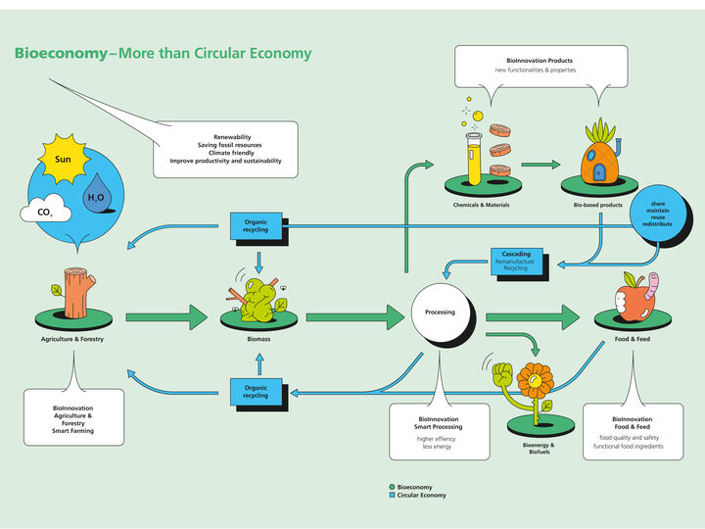

Slide 24
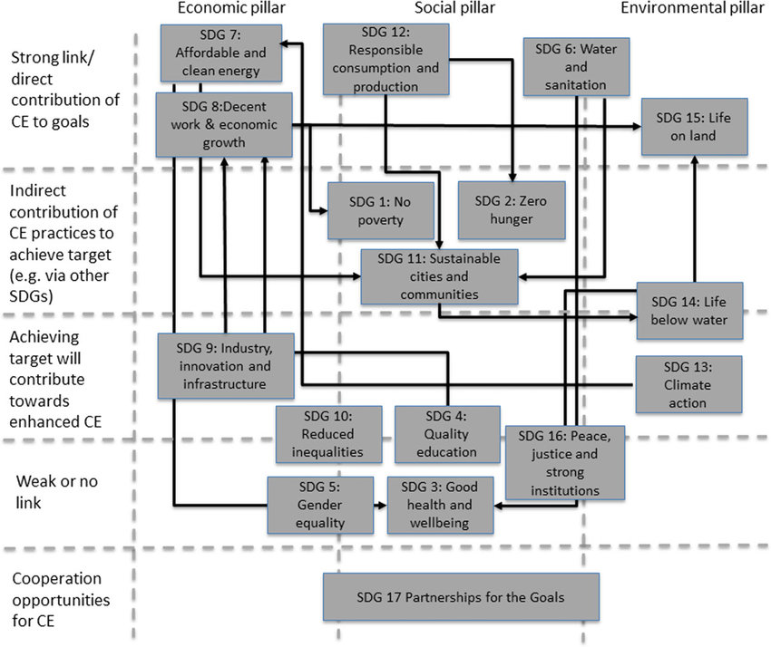

SDG’s and Circular Bioeconomy
Circular bioeconomy could be a ‘policy toolbox’ to align with SDG Goals & Targets
SDG 6 (Water and Sanitation)
SDG 7 (Affordable and Clean Energy)
SDG 8 (Decent Work and Economic Growth)
SDG 12 (Responsible Consumption and Production)
SDG 15 (Life on Land)
Source: Relevance of CE practices to Sustainable Development Goals
SWITCH-Asia Leadership Academy 2020

Slide 25
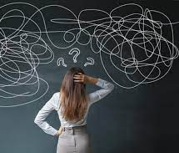
No Easy Solutions
We must tame population growth and reduce unevenness in our consumption patterns.
Sustainable lifestyles and constrained lifestyles are not the same
Resource sufficiency must be looked into and not just focus on resource efficiency
If we don’t then the “circular system” that we may recreate will choke.
There are limits to circularity

Slide 26

Risks of circularity
Promotion of Recycled products in Haste
Absence of risk-based standards
Poor or no Verification
Policy Impact and Risk assessments not conducted on circularity. No one demands!
A bumpy ride expected in the future as we mature in circularity

Slide 27
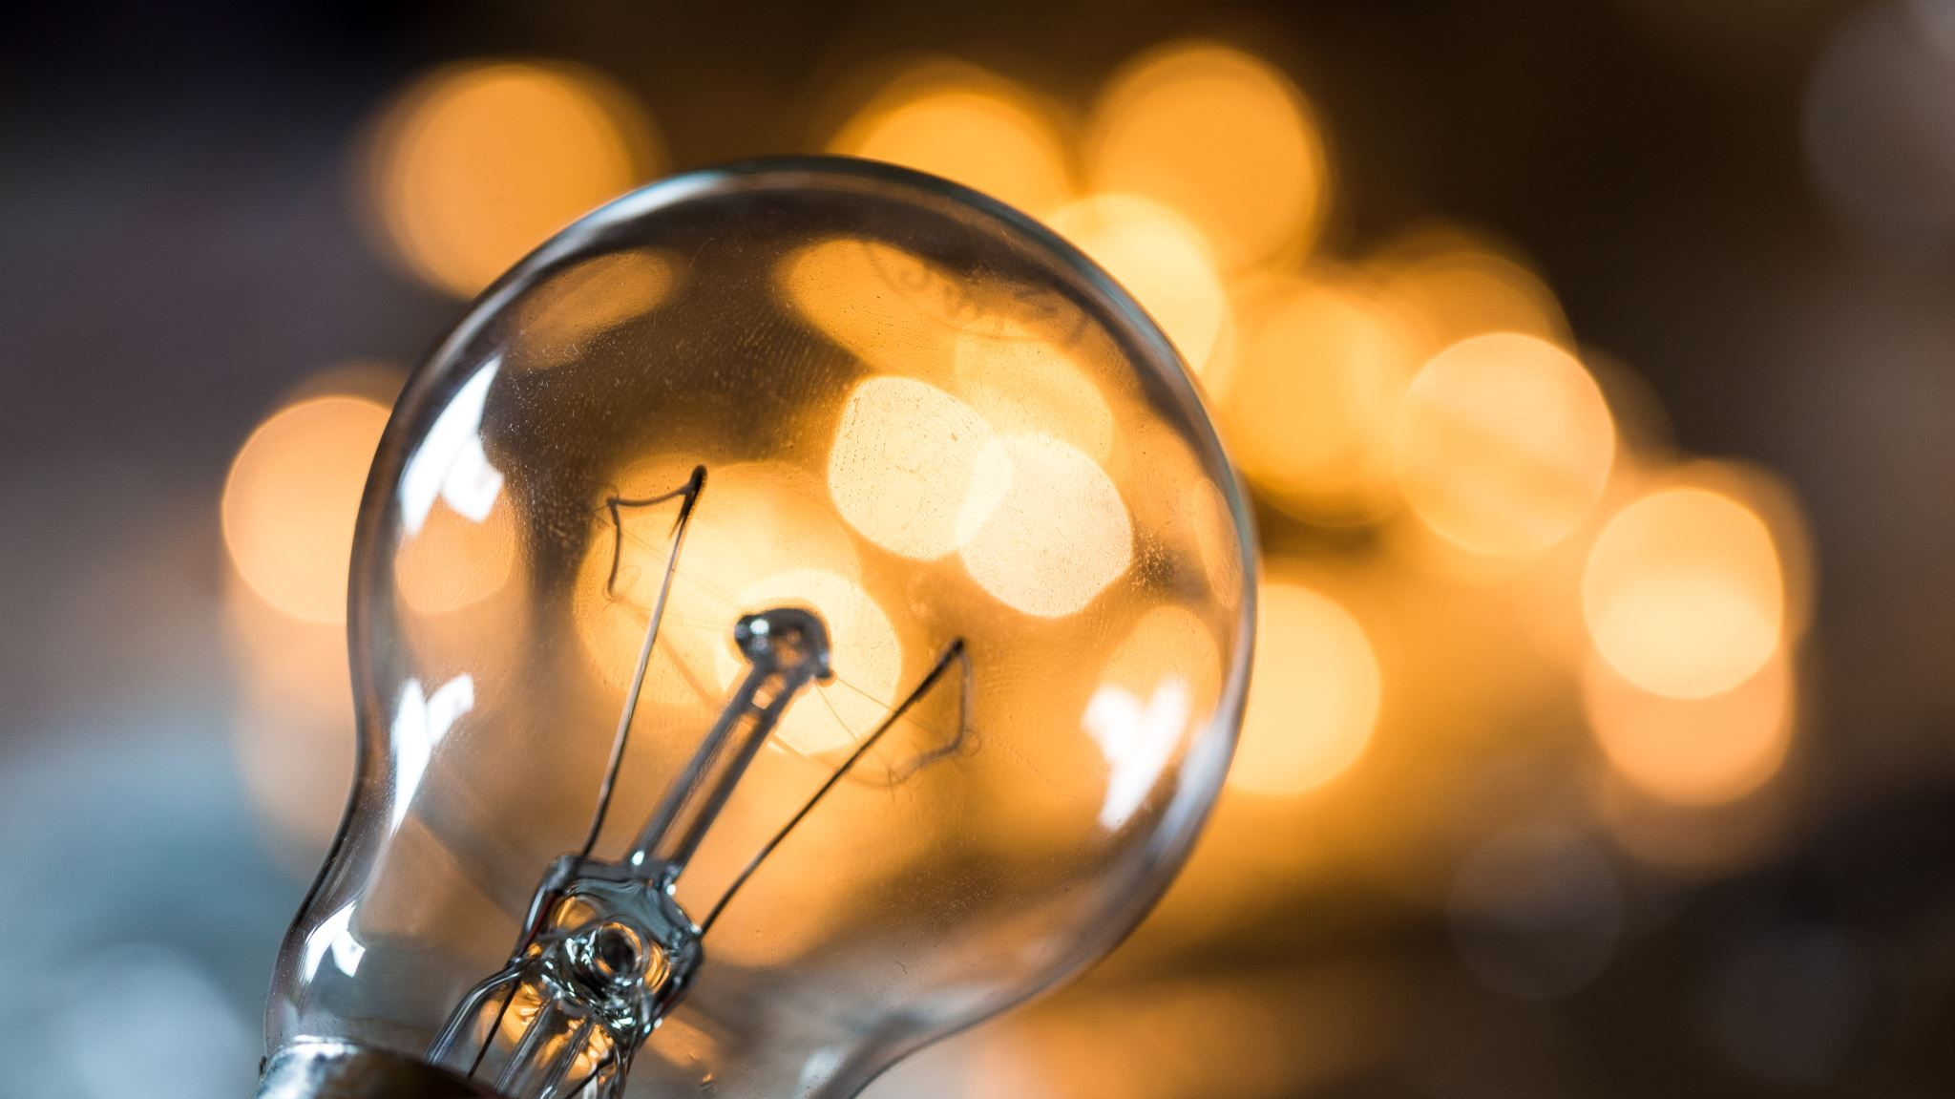
Sadly, there are no conclusions
Thank you

Slide 28
